Slide 1
Random topics on software engineering
#10 – Agile Software Development

Slide 2
Agenda
Software Development Methods
Agile Software Development
Extreme Programming
Scrum

Slide 3
Software Development Methods

Slide 4
Software Development Methods
Framework used to structure, plan and control the development of an IT product
The framework consists of:
a software development philosophy
a set of tools, models and methods used in the development process

Slide 5
Software Development Methods
Two extremes:
agile methods
formal methods
Most methods fall somewhere in between, even if they claim to belong to one of the groups

Slide 6
Agile Software Development

Slide 7
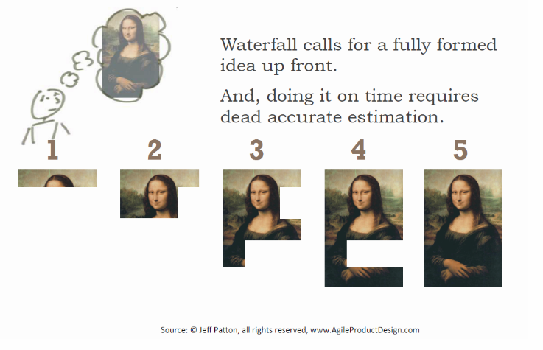
Traditional PM Requires Perfect Vision

Slide 8
Agile Development
Requirements and solutions evolve through the collaborative effort of self-organizing teams
Characteristics
Adaptive planning,
Evolutionary development,
Early delivery,
Continuous improvement,
Rapid and flexible response to change.
Notes:
Agile is not a:
Methodology
Specific Way of Developing Software
Framework or Process

Slide 9
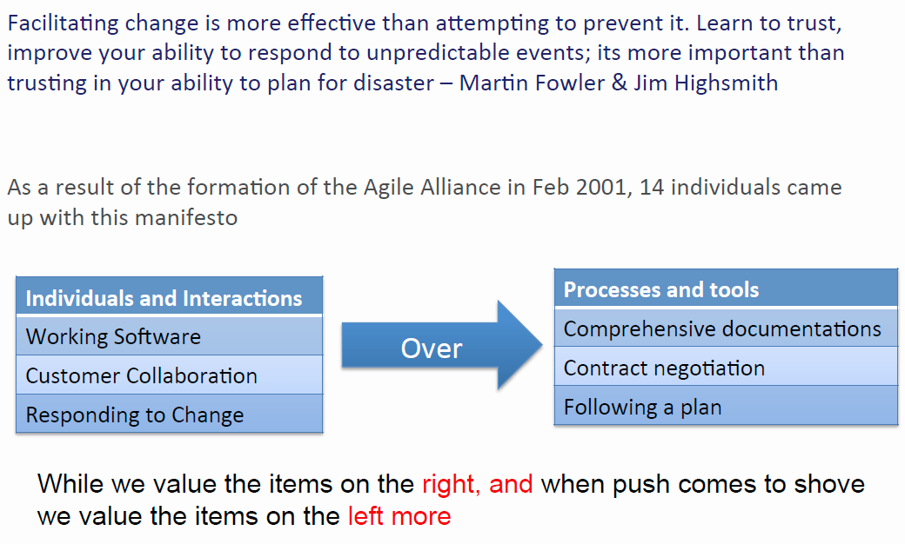
Agile Manifesto http://agilemanifesto.org/

Slide 10
Agile Principles http://agilemanifesto.org/
Our highest priority is to satisfy the client through early and continuous delivery of valuable software.
Welcome changing requirements, even late in development. Agile processes harness change for the client's competitive advantage.
Deliver working software frequently, from a couple of weeks to a couple of months, with a preference to the shorter timescale.
Business people and developers must work together daily throughout the project.
Build projects around motivated individuals. Give them the environment and support they need, and trust them to get the job done.
The most efficient and effective method of conveying information to and within a development team is face-to-face conversation.
Notes:
Keys:
Changing requirements,

Slide 11
Agile Principles http://agilemanifesto.org/
Working software is the primary measure of progress.
Agile processes promote sustainable development. The sponsors, developers, and users should be able to maintain a constant pace indefinitely.
Continuous attention to technical excellence and good design enhances agility.
Simplicity--the art of maximizing the amount of work not done--is essential.
The best architectures, requirements, and designs emerge from self-organizing teams.
At regular intervals, the team reflects on how to become more effective, then tunes and adjusts its behavior accordingly.

Slide 12
7 PRINCIPLES OF LEAN SOFTWARE DEVELOPMENT
Eliminate Waste
Empower the Team (Respect People)
Defer Commitment
Amplify Learning (Build Knowledge)
Deliver Fast
Build Quality In
See as Whole
Notes:
Definition - Anything not needed right now
Book Recommendation - Escape Velocity - Jeffrey Moore

Slide 13
Software Waste
Poppendieck’s 7 types of software waste
Partially done work
Extra processes
Extra features
Task switching
Waiting
Motion
Hand-offs; lack of co-located teams
Defects
Notes:
1. Think of partially done work as inventory, a partially done meal. Code you are working on right now has NO VALUE. Can’t ship it, you can’t sell it.
2. Unnecessary signatures. Executives used to have to sign all outgoing packages. It could take days to chase them down.
3. This is overproduction. Another way to think about it is grocery shopping. Do you ever buy too much of something you already had? Trouble trying to figure out how to use it all before it goes bad and sometimes it does.
4. Multi-tasking. Lose efficiency when switching contexts.
6. There is knowledge lost between handoffs. Agile recommends that a team work in a single area where all roles are there. Takes a lot of motion to track down an answer or the person with the answer if not co-located.
7. We want to get it right the first time.

Slide 14
Paradigm Shift
Fixed
Traditional
Cost
Agile
Features
Date
Flexible
Date
Cost
Features
Notes:
Conventional models used on projects that require frequent adjustment often take too long and don’t hit the mark.
Agile projects connect users and developers to validate work and adjust quickly.
Agile – Commit to delivering value (Working Software)
Prioritize and deliver important, high-risk or complex features first so we meet clients’ basic needs at least, even if the bells and whistles aren’t there.
Agile movement is moving into government, finance, insurance, beyond software technology (Reference Agile 2016)
Do –
Ask –
What happens if we commit to a date and features and it’s late?
Late, increased cost, work overtime
E.G. Fixed scope contracts for CCL (Cerner ate rest of hours)
Solution - Reevaluate our feature set but stick to the date.

Slide 15
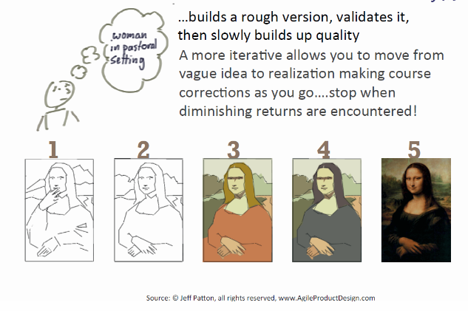
Agile Expects Vision Shift

Slide 16
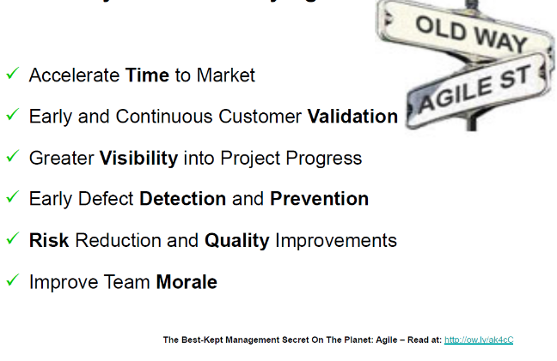
Key Benefits – Why Agile ?
Notes:
You are agile when you are delivering value on a predetermined scheduling

Slide 17
Agile Software Development
Agile != cowboy coding
well defined development process, followed strictly
Rigid control
degradation leads to cowboy coding

Slide 18
Well known methods
XP
Scrum
Crystal Clear (described by Allistair Cockburn)
Open Unified Process (part of Eclipse Process Framework)
Kanban
…

Slide 19
EXTREME PROGRAMMING

Slide 20
Extreme Programming
Software development method described in 1999 by Kent Beck
Based on lessons learned during work on the Chrysler Comprehensive Compensation System project
Based on previously developed methods (e.g. test driven design – early sixties)

Slide 21
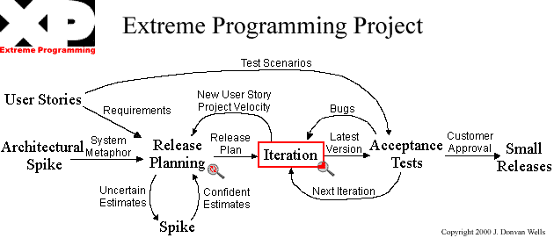
XP - Project

Slide 22
User Stories
Written by the users
Used to estimate time – detailed requirements are given to the programmers
Story implementation should take 1-3 weeks of Ideal Development Time
Divided into technical tasks for programming teams

Slide 23
Release Plan
Set of stories to be included in the next release
Plan for the further releases
80 (+/-20) User Stories per release
Determine:
Scope
Time
Quality
Resources

Slide 24
Releases
Frequent and small
Gives time to fix the important features before end of the project
Customer gets to use the implemented functionality earlier

Slide 25
Project Velocity
How much work is getting done on the project
Sum of user story estimates in previous iteration
Sum of estimates of technical tasks developed by a team in previous iteration
Next iteration -> no more user stories than project velocity, no more technical tasks per team than their project velocity

Slide 26
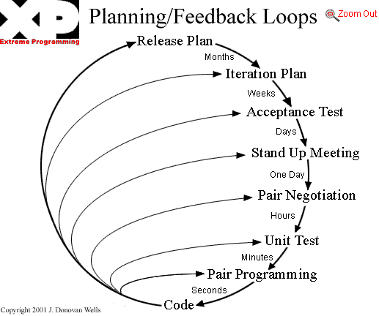
XP - Planning

Slide 27
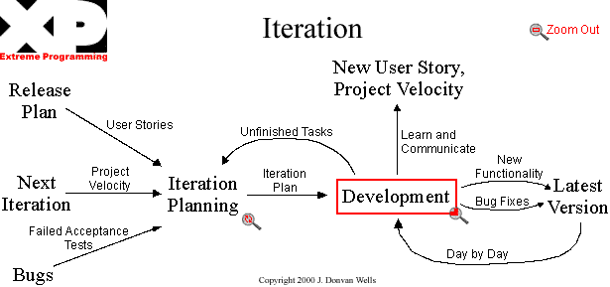
XP – Iteration Plan

Slide 28
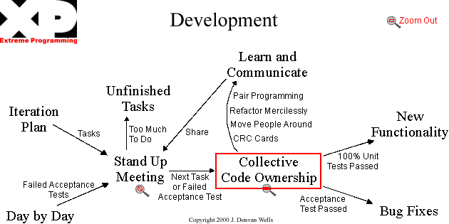
XP Development

Slide 29
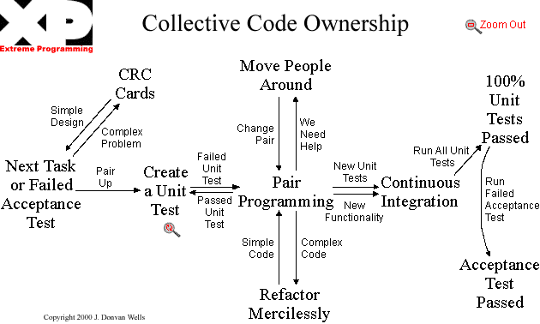
Code Ownership

Slide 30
Moving people around
Everyone should know about each section of code base
Program in pairs
People should not work in the same team and pair all the time
Helps avoid knowledge loss
Provides cross-training
Allows better allocation of people

Slide 31
CRC Cards
Class, Responsibilities, Collaborations – information on a card
Gives information about a class
Used as documentation and as a tool in design process

Slide 32
Spike Solutions
Short, small programs used to explore potential solution to a problem
Not good enough to keep, just to find out if a solution is good enough
Used to reduce technical risk or improve estimates

Slide 33
Don’t add functionality early
Concentrate on what is supposed to be done now
The prematurely added functionality may turn out to be unnecessary

Slide 34
Refactor
Remove unnecessary code
Remove redundant code
Rejuvenate obsolete code
Keep the design simple and the code clean

Slide 35
Code unit tests first
First code unit tests, then code to be tested
Test everything of value to the customer
Immediate feedback on code’s validity
(so called Test Driven Development)

Slide 36
Pair Programming
Two programmers, one computer
One person codes, the other one thinks ahead
Makes spotting errors and coming up with good solutions easier

Slide 37
Sequential integration
Only one pair integrates code at the same time
After the integration everything that worked correctly before has to work correctly

Slide 38
Integrate often
Keeping code not integrated for a long time is asking for trouble
Avoid fragmentation of effort and diverging development

Slide 39
Don’t optimize early
Optimization effort may be wasted in refactoring later
Make the code work first, make it work faster later

Slide 40
No overtime
Work 8 hours per day and no longer

Slide 41
SCRUM

Slide 42
Scrum
Rugby - the whole team "tries to go to the distance as a unit, passing the ball back and forth„ (according to the Scrum authors, the reality is a bit different)
Incremental software development method

Slide 43
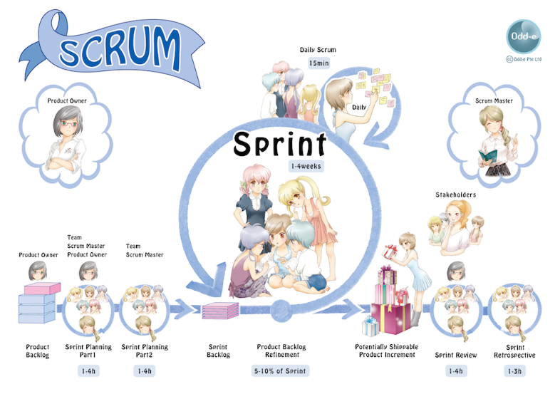
Scrum development process

Slide 44
Product Backlog
prioritized set of high level requirements of work to be done
describes the software requirements

Slide 45
Sprint Backlog
set of requirements to be implemented in a single sprint
determined durign sprint planning meeting by the Product Owner
the requirements are frozen for a sprint

Slide 46
Scrum Roles
Pigs – those with their bacon on the line
Chicken – everyone else involved with the project

Slide 47
Pig roles
Product Owner – voice of the customer. Writes the user stories, manages product backlog
Scrum Master – buffer between the team and outside distractions, enforcer of rules
Team – people doing the actual work ;-) . Small, cross-trained

Slide 48
Chicken roles
Users
Stakeholders (involved in reviews)
Managers

Slide 49
Scrum Meeting
The meeting starts precisely on time. Punish those coming late
All are welcome, but only "pigs" may speak
The meeting is timeboxed at 15 minutes regardless of the team's size.
All attendees should stand
The meeting should happen at the same location and same time every day

Slide 50
Scrum Meeting
Three questions for each person:
What have you done since yesterday?
What are you planning to do by today?
Do you have any problems preventing you from accomplishing your goal?

Slide 51
Sprint Retrospective
Meeting at the end of a sprint
Two questions:
What went well during the sprint?
What could be improved in the next sprint?

Slide 52
END NOTES

Slide 53
Recommended Reading
Kent Beck: Extreme Programming Explained: Embrace Change, Addison-Wesley.
Alistair Cockburn: Agile Software Development, Addison-Wesley.
Ken Schwaber: Agile Project Management with Scrum, Microsoft Press

Slide 54
Thank you for your attention

